Slide 1
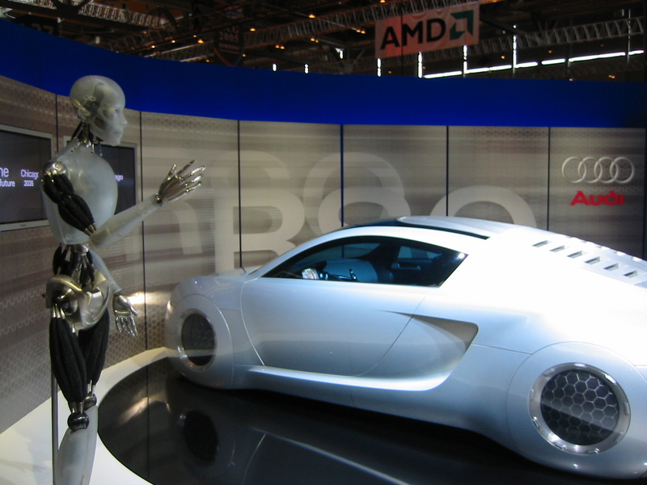
VOICE CONTROLLER CAR
Arbind sah 19BEM1056
Gursevak singh 19BEM1054
Harjaap singh 19BEM1019
Arush 19BEM105
Rajan 19BEM1024
Students, CU,
Kharar Punjab
Requirement analyst
Coding
Framework design
Report and ppt design

Slide 2
ABRTRACT
This project builds a voice controlled car that can be controlled by voice commands which reacts in accordance to the corresponding voice command. Simple voice commands like DANCE , left, right, forward, back, stop, red light , right side yellow and so on.. are used to run the car. These commands are given to Bluetooth module via to android application. The Bluetooth module and control unit are combined to store and test the voice commands. When an instruction for the automobile (car) is identified, a command message is sent to Arduino UNO, This command is analyzed by the microcontroller of arudino and followed up, In the car, Image processing can be utilized to become aware of the shade and the obstacles. This work has been limited to the ZigBee system in the short-range (100mts range), and is linked to the car over long distance via long-range module

Slide 3

Keywords:
Arduino UNO, Bluetooth module, Image processing, zigbee system, speech recognition.
INTRODUCTION:
This project is related to a voice controlled car, which
makes this project speech an important part of identifying
commands and delivering them to the car via a wireless
system. Identification of speech is also called as "automatic
speech recognition (ASR)".This undertaking has numerous
elements like, interaction between laptop and
microprocessor, input and understanding of speech, Wireless
numerical data distribution microprocessor to
microprocessor, the control of several motors using
microprocessors.

Slide 4
PROBLEM STATEMENT
In today’s time technology is growing rapidly, so everyone wants everything to be automated, using the same old technique to
control or use car is very old class, so people find it really time consuming.
*People who’s are handicap or not able to drive car, this project will be very helpful for them.
Also ELON MUSK has also introduced the tesla cars because, of the also public has become so impatient in every case.
To overcome all these problems, this smart home allows them to control their car on any smart device or even on our voice
(smart phone etc ) .

Slide 5
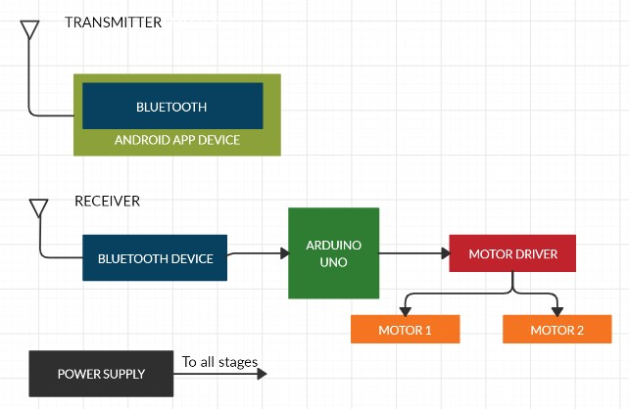
Block diagram of voice controlled car

Slide 6
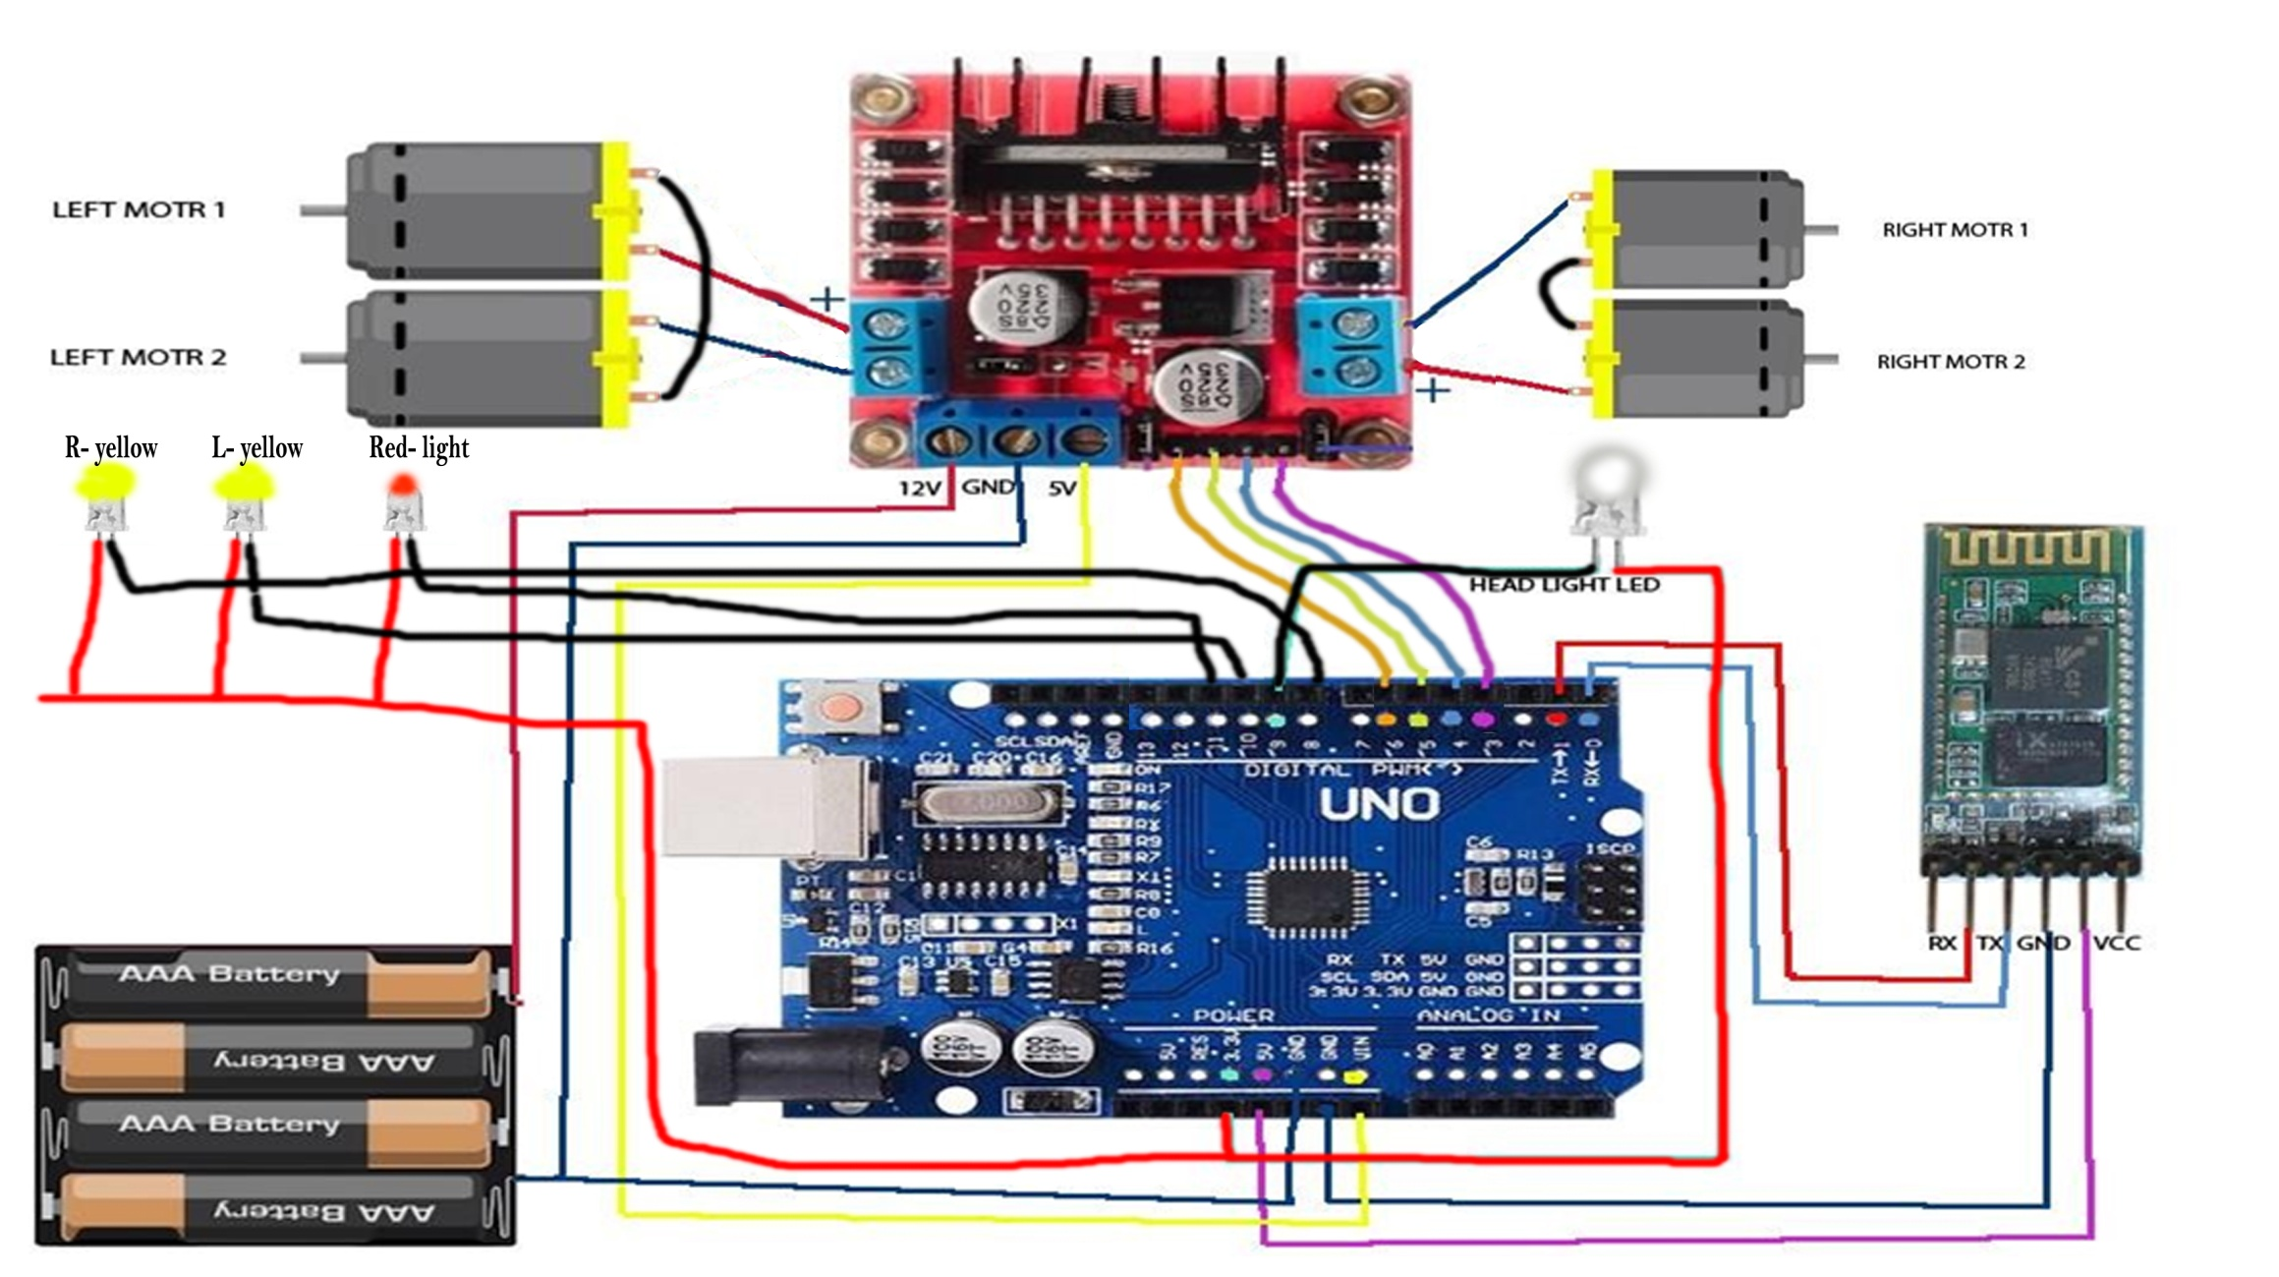
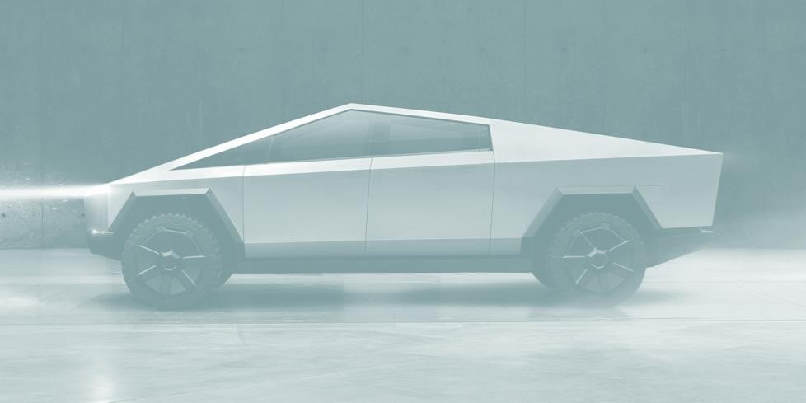
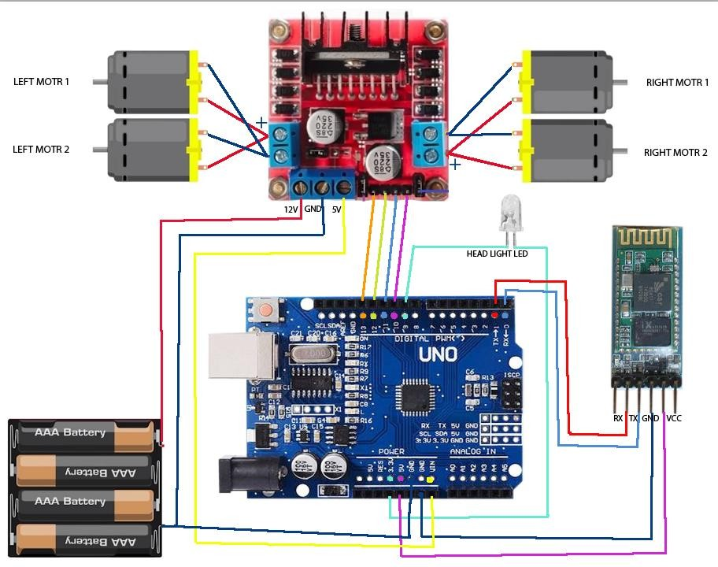
Working

Slide 7
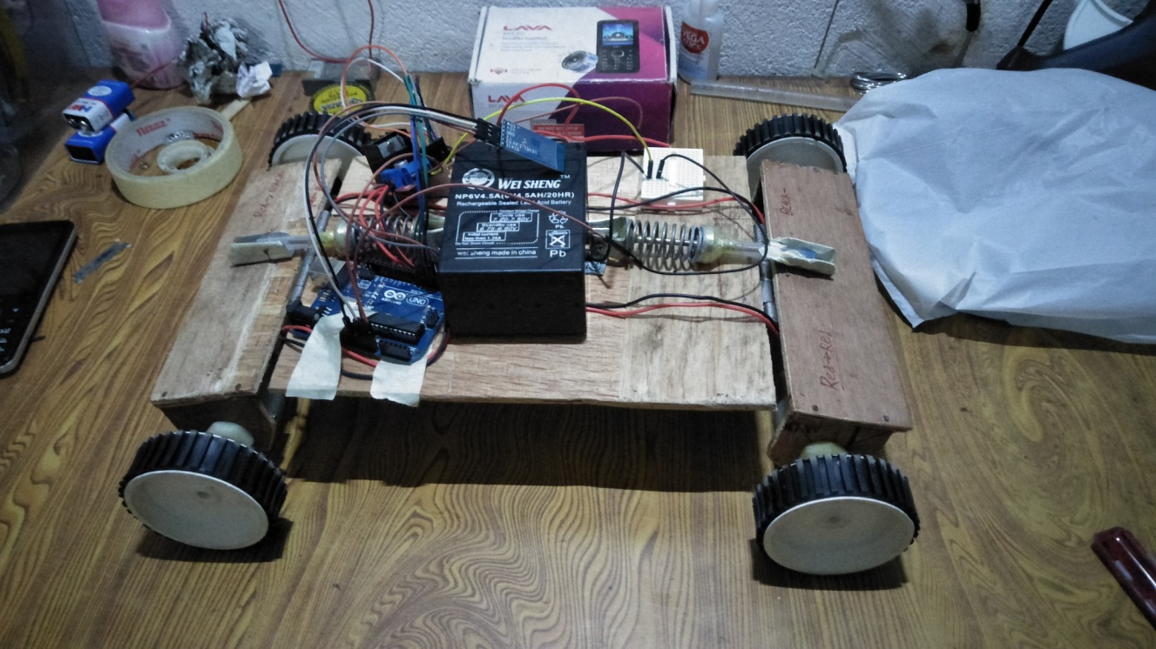
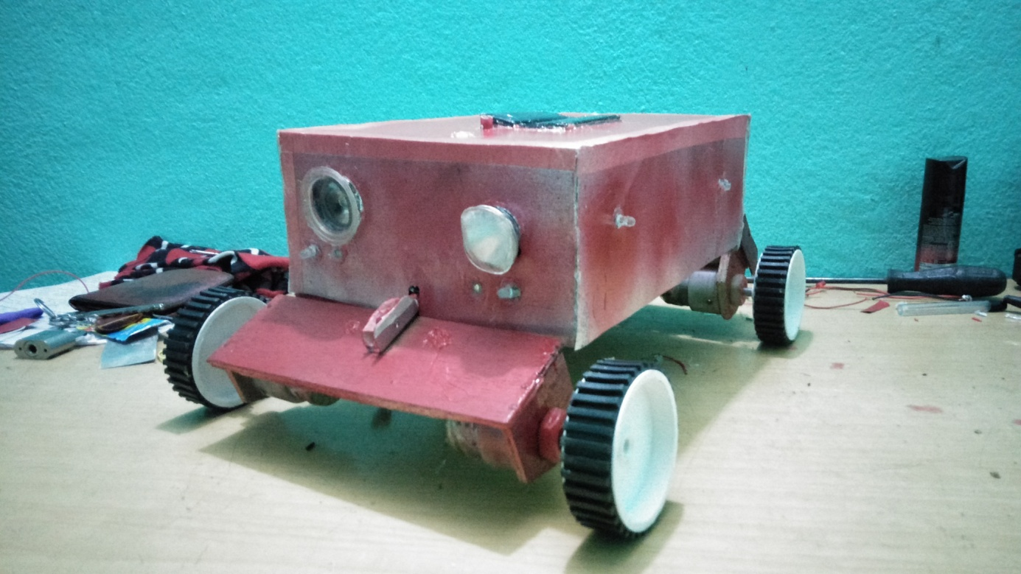
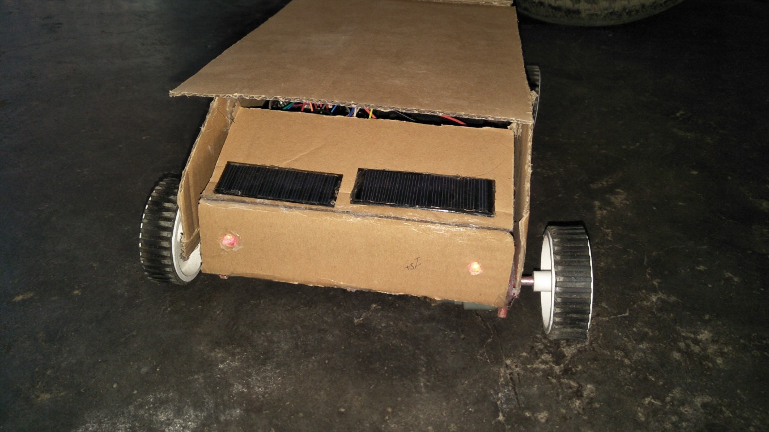
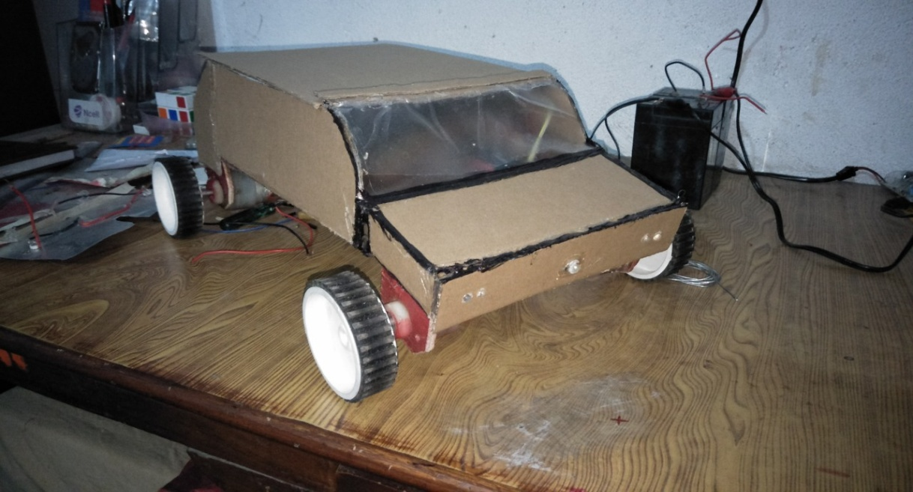

Slide 8
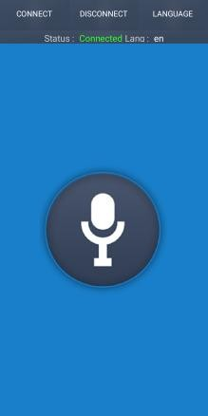
Status Connected
Results
Aiming 8.5 million profit in next 5 years
Voice controlled car is working and all the functions are followed by the bot. Unlike DTMF robot, the car is connected to the mobile phone wirelessly making it comfortable to the user to control the car. Control car is working on every feature like forward-backward left right it slide light redlight dance many more.

Slide 9


